Slide 2
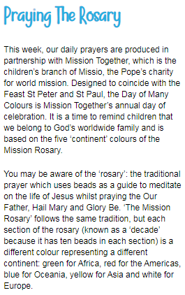
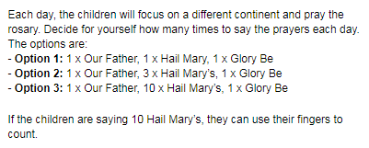
Monday 29th June
Morning prayer
https://www.tentenresources.co.uk/daily-prayers-for-home

Slide 4
This week, we are looking at words that all contain a sound that is made with two letters but only one is actually spoken. They all have a silent letter.
The name for two letters that make one sound is a digraph. Can you spot the digraph in each of these words? Write them down and draw a circle around the digraph and a line under the silent letter.
thumb
b
calm
doubt
l
b

Slide 5
Read the sentences and choose the best spelling word to complete each one.
“Please use your ________ and fork,” the lunchtime supervisor reminded the children.
To ________ my own book is my ambition.
‘The doorbell is broken. ________ loudly,’
the sign on the door read.
“No, I don’t want any pudding, thank you,” came Clem’s __________.
answer
write
knock
knife

Slide 6
Use the picture word, island, in a sentence using a preposition.

Slide 7
Spellings Monday
Today’s words
island
answer
write

Slide 8
Reading Monday
We’ve noticed that there are not many of you doing Bug Club each day.
Please log on, read your books and remember to answer the questions!
We are checking each week to see who is reading!

Slide 9
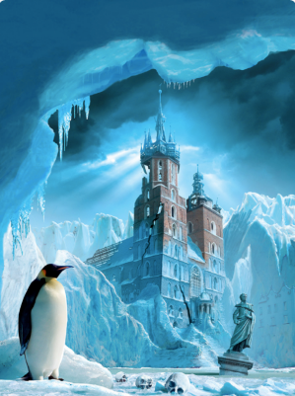
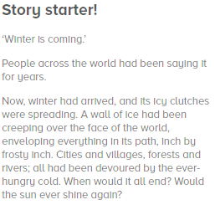
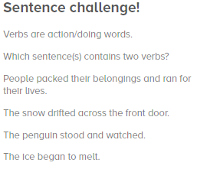
Creative Writing Monday
Finish the Story! Can you include verbs like in the sentence challenge too?

Slide 10
Maths Monday
Remember:
Please log in to these for maths before you do My Maths. These will help you with the tasks for My Maths this week.

Slide 11
Maths Monday
Remember daily:
There are 10 tasks this week. You can do all the times tables tasks, or pick the ones that you know were your target times tables before lockdown.
Monday: MIxed sums over 100,
Tuesday: column addition,
Wednesday: column subtraction,
Thursday: estimates and inverse,
Friday: addition and subtraction Year 3 Overview

Slide 12
Topic – History
Horrible Histories television show will host 'Home School History', which will provide 15 minute History lessons across a range of topics.
Tune in at 9.30 am on Mondays from 20th April.
The lessons can be found at the following link: https://www.bbc.co.uk/programmes/m000hmmf
You can catch up on any missed episodes here.

Slide 13
Topic
See the Topic Powerpoint for:
RE
Science
History
Music
PSHCE
Choose something to do today

