Slide 2
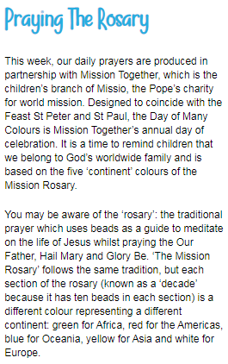
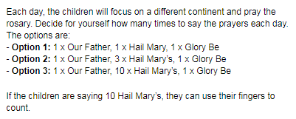
Wednesday 1st July
Morning prayer
https://www.tentenresources.co.uk/daily-prayers-for-home

Slide 3
Spellings Wednesday
Today’s words
thumb
doubt
half
calm

Slide 4
Reading Wednesday
We’ve noticed that there are not many of you doing Bug Club each day.
Please log on, read your books and remember to answer the questions!
We are checking each week to see who is reading!

Slide 5
Reading
For the next couple of weeks, your reading and writing will be linked to your Science topic about parts of the flower and how a flowering plant will reproduce.
Today, (or the next day you have good weather) try to go on a Plant Hunt either in your garden at home, or your neighbourhood, or local park or garden.
Use ideas from the following slides.
(it says school and teacher, but just imagine it is home, and grown up!)

Slide 6
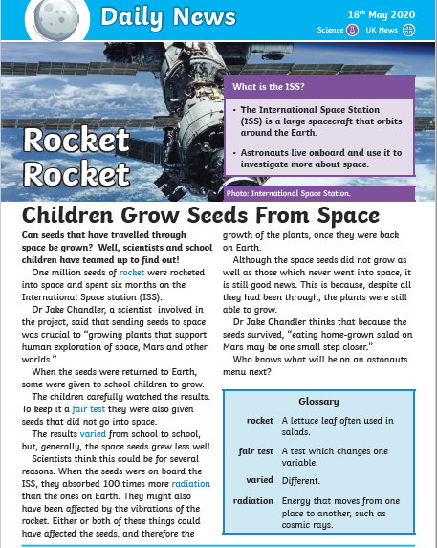
Reading

Slide 7
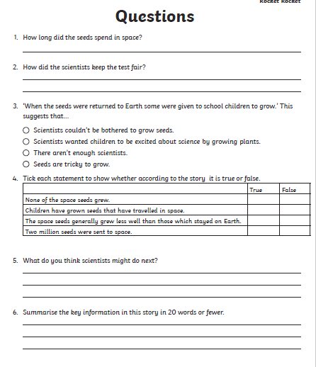

Slide 9
A New Discovery
WRITING
Imagine that you are a plant hunter!
You have made a new discovery, finding a new plant that nobody has ever seen before.
?
What will you call it?
?
What does it look like?
?
How does it take in water and light?
?
How will you care for it?
Use your New Discovery Activity Sheet to draw a picture of your new plant and explain what it needs to grow healthily.

Slide 10
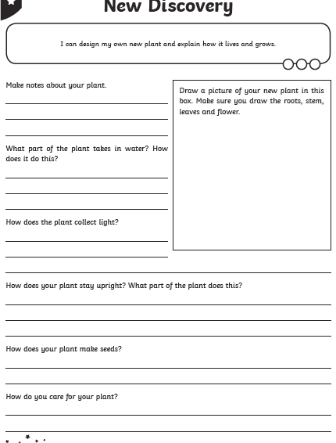

Slide 11
Maths Wednesday
Remember:
Please log in to these for maths before you do My Maths. These will help you with the tasks for My Maths this week.

Slide 12
Maths Wednesday
Remember daily:
There are 10 tasks this week. You can do all the times tables tasks, or pick the ones that you know were your target times tables before lockdown.
Year 3 Booster:
Monday: Ordering whole numbers
Tuesday: Place value
Wednesday: Greater than, less than
Thursday: estimating amounts
Friday: number and place value 3 Overview

Slide 13
Topic
Choose something to do today
See the Topic Powerpoint for:
RE
Science
History
Music
PSHCE

