Slide 1
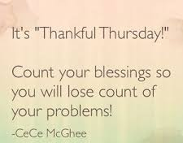

Slide 2
Thursday 9th July
Morning prayer
https://www.tentenresources.co.uk/daily-prayers-for-home

Slide 3
Spelling
The spelling tasks this week are based on this half term’s spelling words.
Here is a list of this term’s spelling words to help you.

Slide 7
Reading Thursday
We’ve noticed that there are not many of you doing Bug Club each day.
Please log on, read your books and remember to answer the questions!
We are checking each week to see who is reading!

Slide 8
Drop Everything And Read Log on to our Year 3 Eschools Page and I will post a video of me reading the class text to you

Slide 10
Maths Thursday
Remember:
Please log in to these for maths before you do My Maths. These will help you with the tasks for My Maths this week.

Slide 11
Maths Thursday
Remember daily:
There are 10 tasks this week. You can do all the times tables tasks, or pick the ones that you know were your target times tables before lockdown.
Year 3 Booster:
Monday: Ordering whole numbers
Tuesday: Place value
Wednesday: Greater than, less than
Thursday: estimating amounts
Friday: number and place value 3 Overview

Slide 12
Topic
Science and History projects are due tomorrow!
See the Topic Powerpoint for:
RE
Science
History
Music
PSHCE

