Slide 1
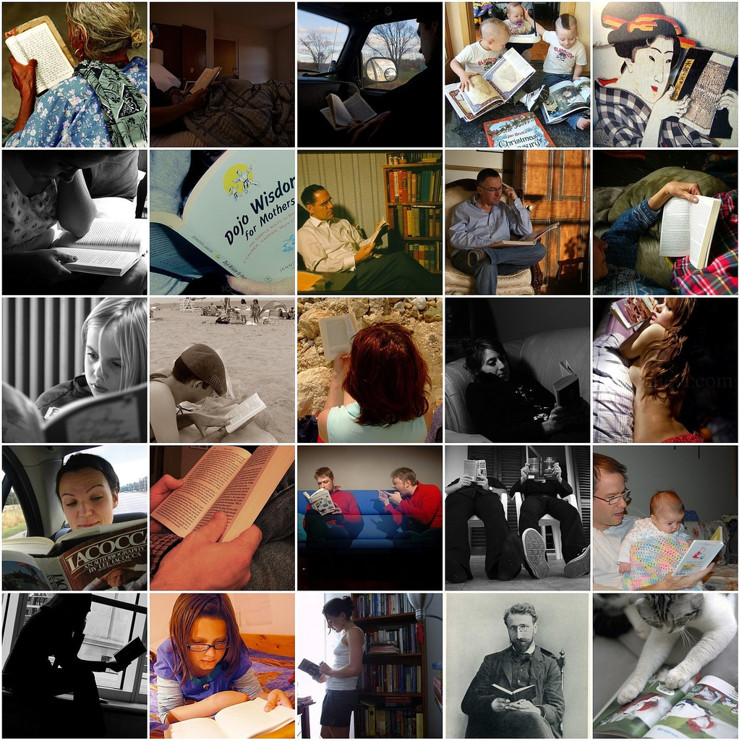
“Kids need reading stamina”
Developing a reading culture at Thomas Deacon Academy

Slide 2
Why read?
Why books?

Slide 3
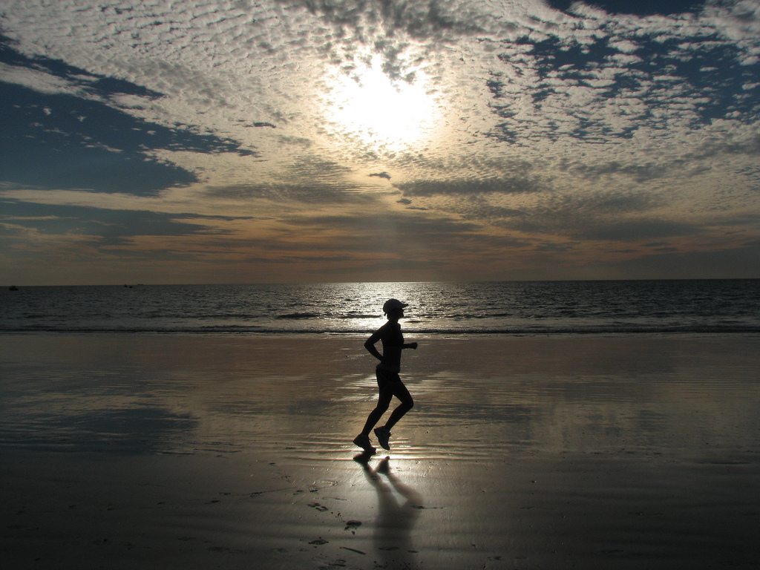
"Reading is to the mind what exercise is to the body." Richard Steele

Slide 4
The ability to read is one of the strongest predictors of future success.
Although reading can be taught in a classroom,
it must be practised.
This slide and next: Are librarians really worth it? Available online at:
http://www.ccsd.net/schools/watson/libraryresearch.html

Slide 5
Michael Jordan can teach you to how to throw the perfect foul line shot, but if you don't ever practise the skill, his instruction is worthless.
When students voluntarily read, they practise and enforce what is taught in the classroom.

Slide 6
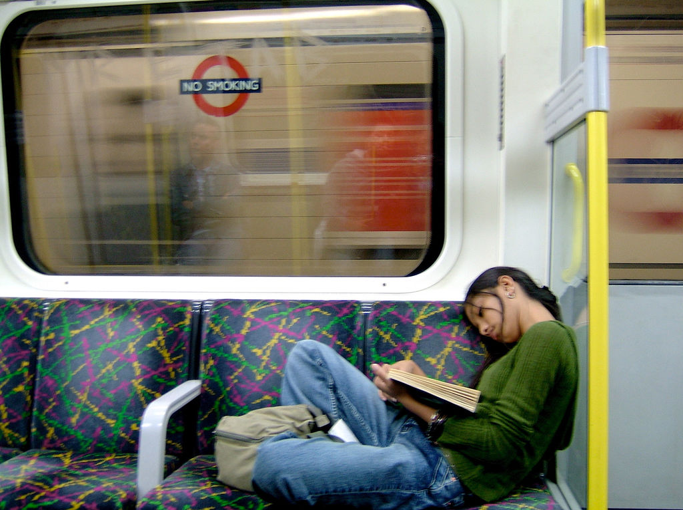
OECD “Reading for Change” 2002 found that
“Being more enthusiastic about reading and a frequent reader was more of an advantage, on its own, than having well-educated parents in good jobs”

Slide 7
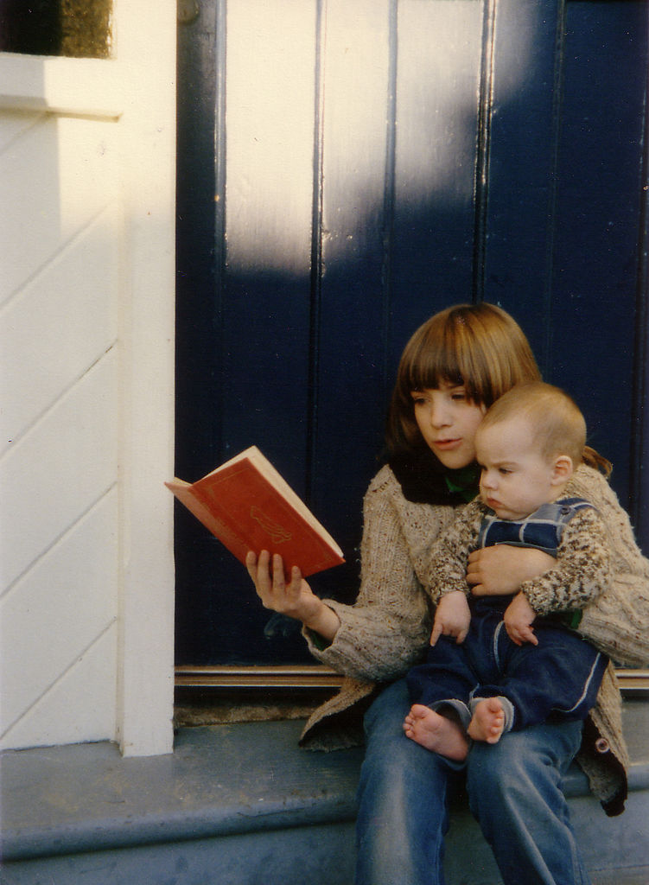
“Finding ways to engage students in reading may be one of the most effective ways to leverage social change."
OECD (2002). Reading For Change: Results from PISA 2000, published by the Organisation For Economic Co-operation and Development.

Slide 8
Reading for pleasure
=
Cultural
heritage
Creativity and imagination
Language development
Increased self-esteem
Emotional development
Sustained concentration

Slide 9
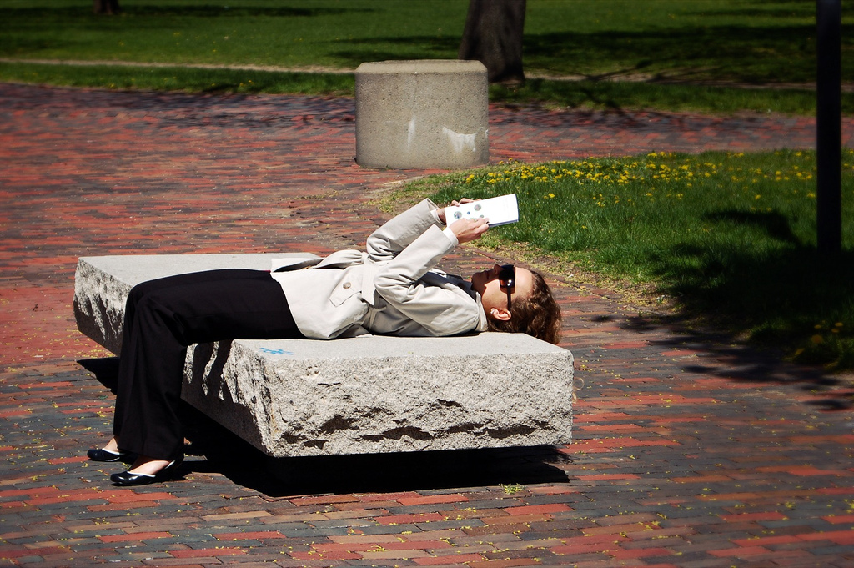
“There is a strong association between the amount of reading for pleasure children reported and their reading achievement.”
Twist, L., Schagen, I. and Hodgson, C. (2007). Readers and Reading: National Report for England 2006. Slough: NFER

Slide 10
Reading….
…doesn’t always have to be from books

Slide 11
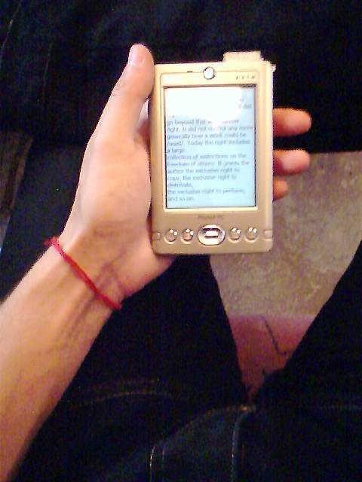
Magazines and comics
Websites
TXT messages
E-books
Newspapers
…are all forms of reading!

Slide 12
Why books?

Slide 13
“Books rule! You don’t have pictures to tell you how to imagine something, you can do it yourself! Books can do what no machines can, and probably never will. For example, time travel and they can take you to other dimensions! They are somewhere to go when you just want to escape the real world!” Dani, 13

Slide 14
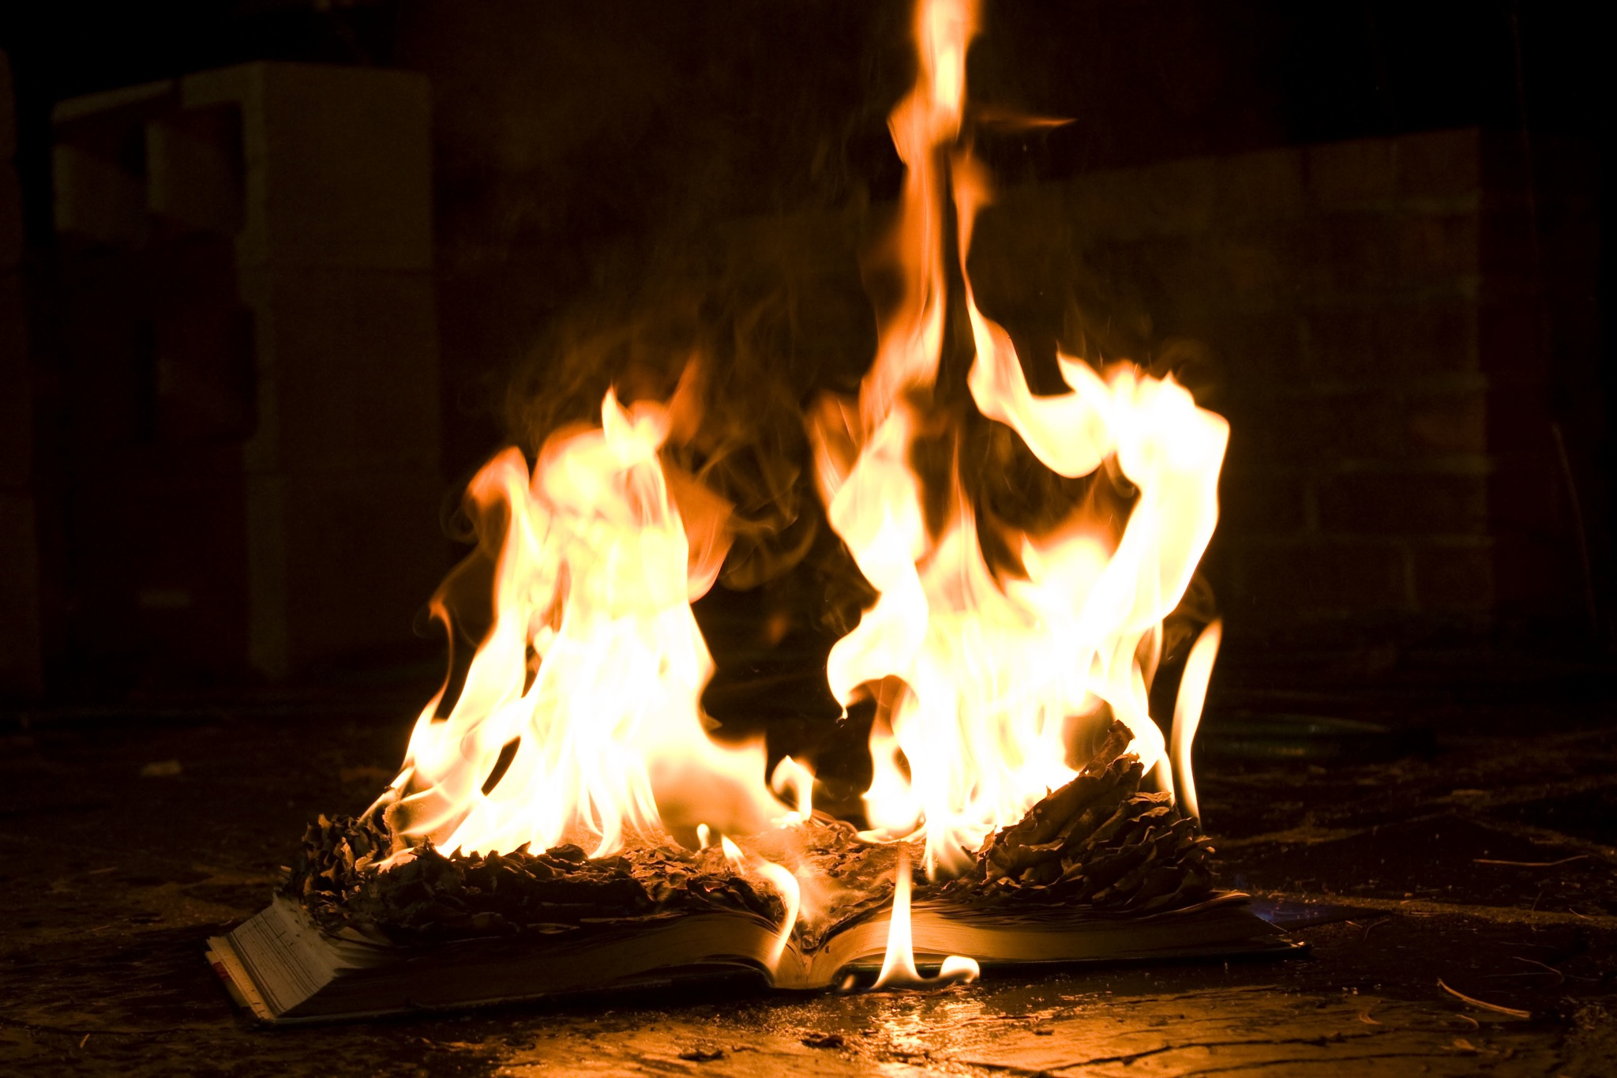
"You don't have to burn books to destroy a culture. Just get people to stop reading them." Ray Bradbury

Slide 15
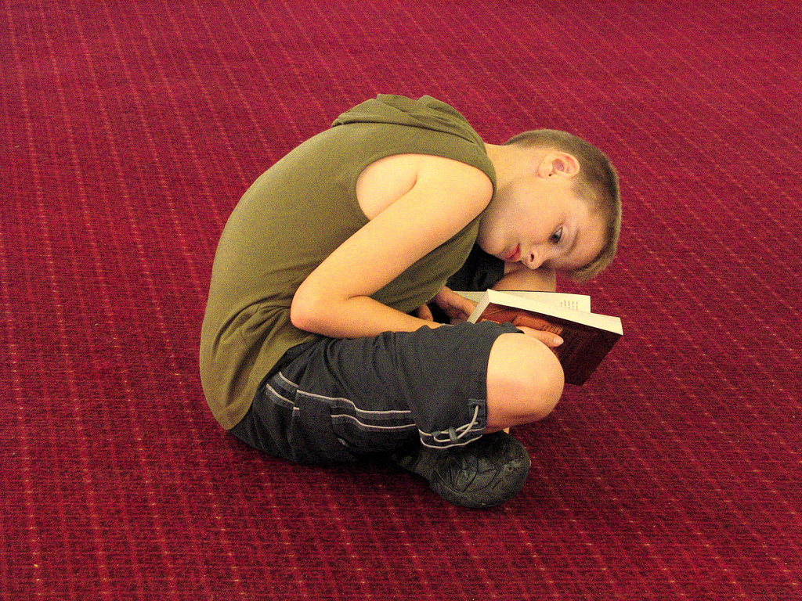
“A significant number of boys would rather chew off their own right leg than confess to enjoying reading and writing.” Alan Gibbons

Slide 16
What does this mean?
Impact on all subjects
and exam courses
Lack of engagement with culture
Stalling of reading & literacy development
Problems with concentration and attention span

Slide 17
“The research evidence suggests that encouraging reading for pleasure could be a way of contributing towards raising educational standards and combating social exclusion.”
Clark, C and Akerman, R (2006). Social inclusion and reading: an exploration. National Literacy Trust

Slide 18
“Sustained reading to my mind is essential for developing a world they would want to live in. The reading does not need to be fiction but I do believe that kids need reading stamina. Just like you have to stick at anything and practice etc surely you need to do the same with reading.” Ingrid Hopson SLYA 2007

Slide 19
So what could we do?

Slide 20
We need time for reading…

Slide 21
Suggestions for Parents
Positive attitude to books
Role models with reading
Join the library and go regularly
Books & Reading material around the home

Slide 22
“Parents must remember its not their job to teach kids to read, it is to encourage them to love books.”
Michael Rosen 2012

Slide 23
Becoming a reader requires reading outside of school, in the home.
Children need to be reading for pleasure.

Slide 24
“Children moving through primary school and into secondary school without acquiring the habit of reading, may not develop the necessary reading stamina that is an essential part of being a capable reader (and writer).”
Stephen Rickard “Why Children Don’t Read”

Slide 25
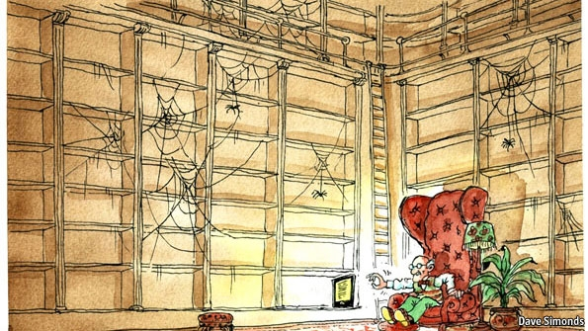
Of 18,000 children questioned, one third did not own a single book.
Ten years ago this was 1 in 10
“Mapping the interrelationships of reading enjoyment, attitudes, behaviour and attainment” NLT 2011

Slide 26
A place to keep their books

Slide 27
A place to read?

Slide 28
Take an interest in what they are reading and listen to them read.

Slide 29
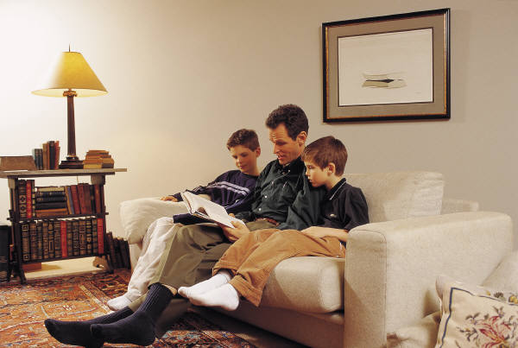
Reading Models?

Slide 30
Encourage
them to read something new.

Slide 31
Those that read a book a week or more were likely to enjoy reading and do better in school

