Slide 1

World
Wide
Web
Eli and Ben Shirvill

Slide 2
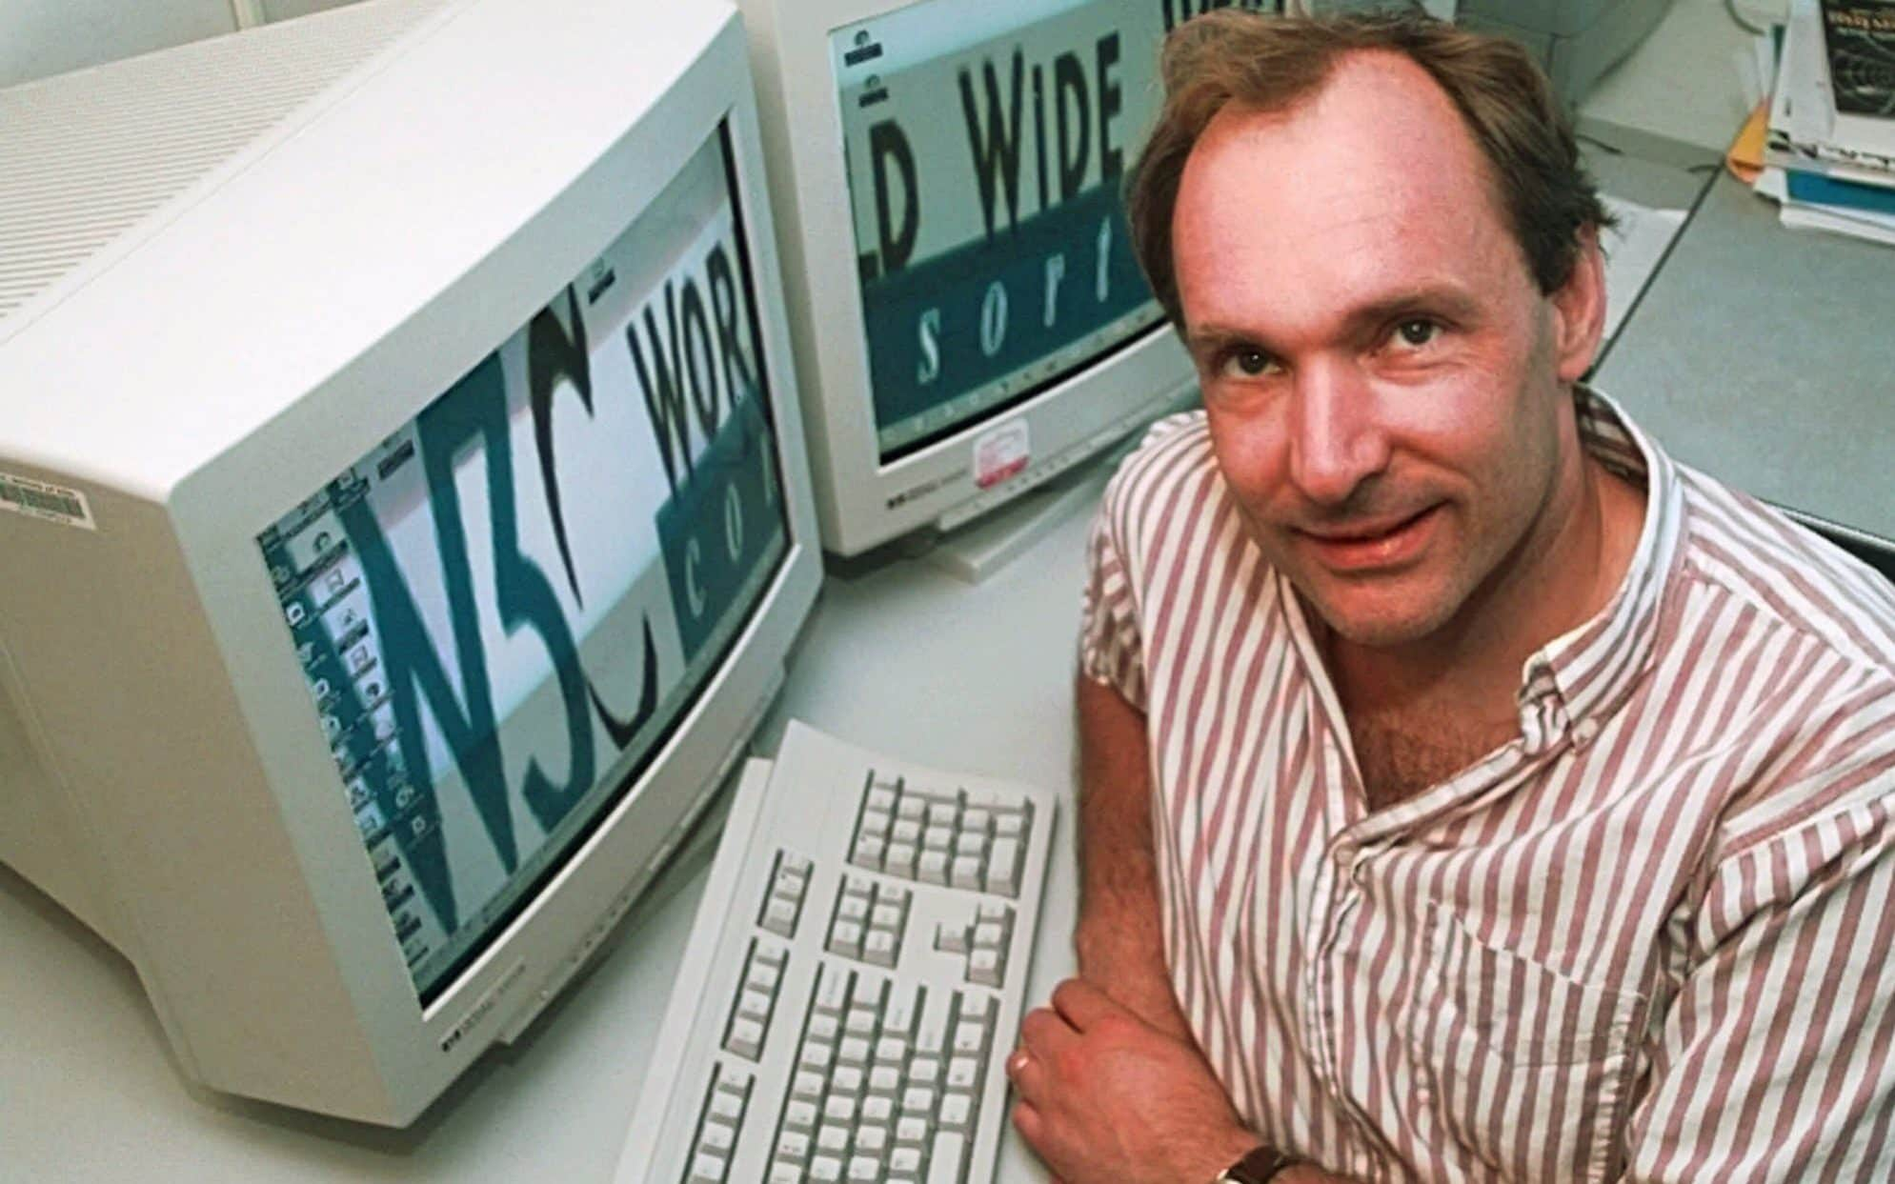
Tim berners- lee created www in 1989 which helped people send data and communicate.

Slide 3

The www is different to the internet - it made the the internet more user friendly.

Slide 4
The first website only had word and pictures that’s right - no videos or social media feeds!

Slide 5
In 1993 the internet opened for anyone to use, allowing people and companies to start their own websites.

Slide 6
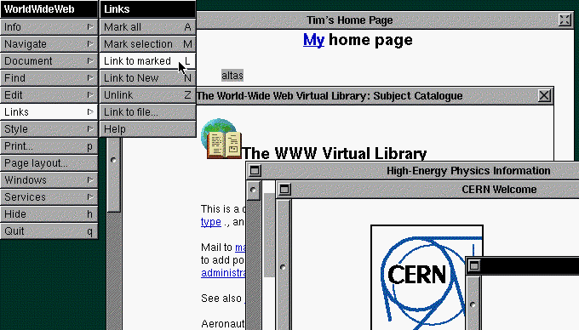
A screenshot of the world's first web browser.

