Slide 1
Welcome to Reception at Christ the King

Slide 2
Foundation Stage Curriculum
Follows on from what the children have been doing in Pre-School and Nurseries.
3 Prime areas:
Personal, Social and Emotional Development
Communication and Language
Physical Development
4 Specific areas:
Literacy
Mathematics
Understanding the World
Expressive arts and design

Slide 3
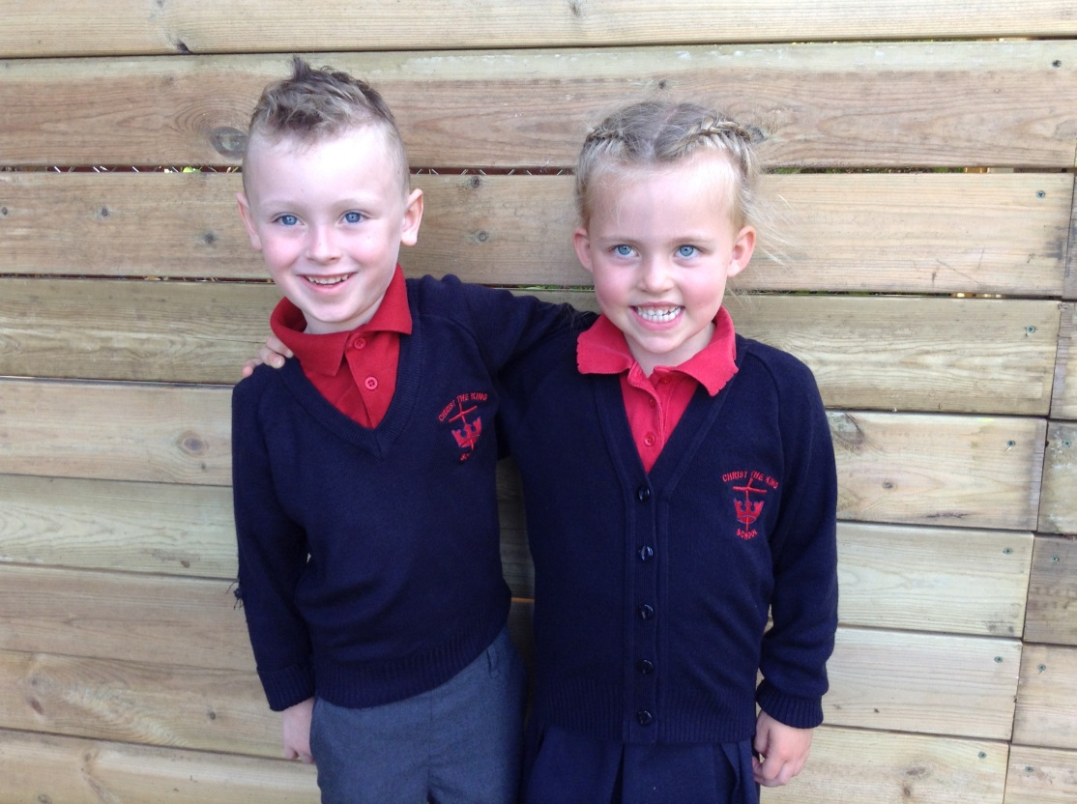
What do I wear?

Slide 4
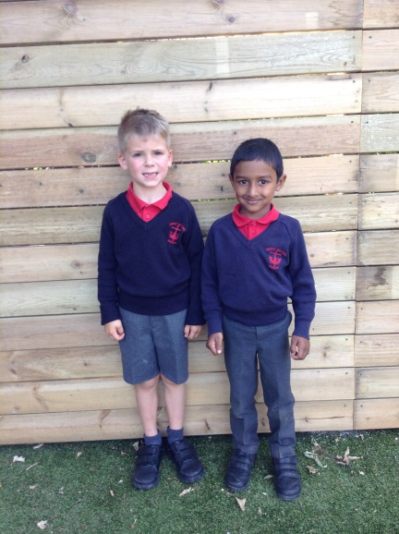
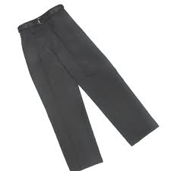
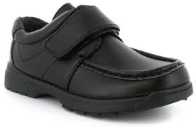
If I’m a boy
Grey trousers/shorts
Red polo shirt
Navy blue school jumper with logo
Grey socks
Black shoes with velcro fastening (not trainers/laces)

Slide 5
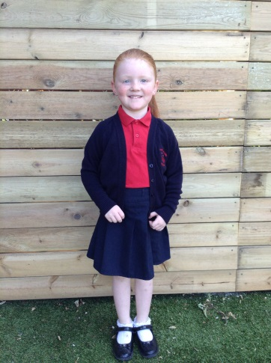
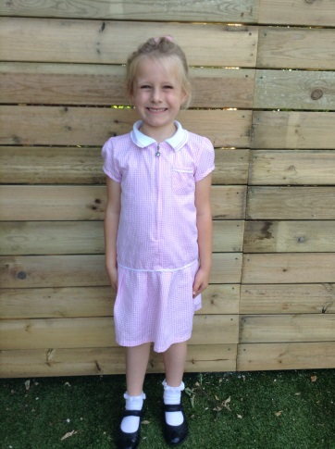
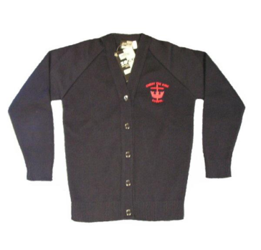
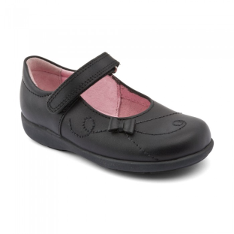
If I’m a girl
Navy blue skirt or pinafore dress
Red polo shirt
Navy blue school cardigan with school logo
White socks or navy/red tights
Black strapped on shoes (boots/open-toed/slip on shoes/laces are not allowed)
Summer Uniform
Pink gingham checked dress (not red)

Slide 6
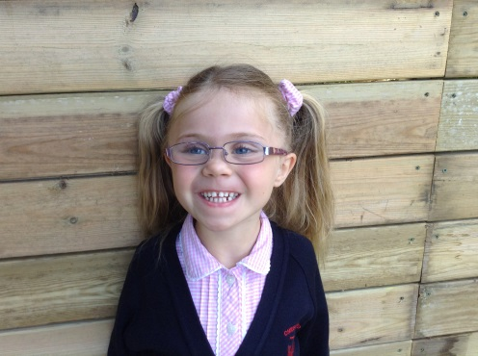
Long hair must be tied up. Large bows/hair extensions are not suitable for school – please save them for the weekend!
Earrings should be studs only – they must be removed/taped over for PE.
No other jewellery to be worn.
No nail varnish.
No temporary tattoos.

Slide 7
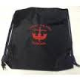
What else?
Specific PE and Music lessons.
What do I need for PE?
PE kit – white polo shirt with the school logo, navy blue shorts, white ankle socks, navy track suit (top and bottoms) and trainers.
NAME IT OR LOSE IT!
PE kit needs to be in a PE bag and kept in school.
Currently, on PE days and due to Covid 19, children will come into school in their PE clothes. We will send further information nearer the time and inform you also of any changes to this.

Slide 8
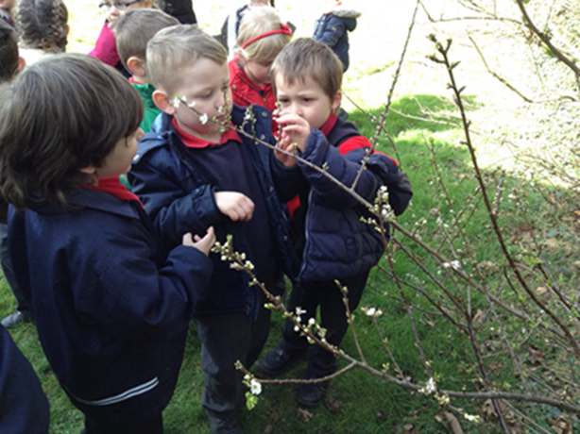
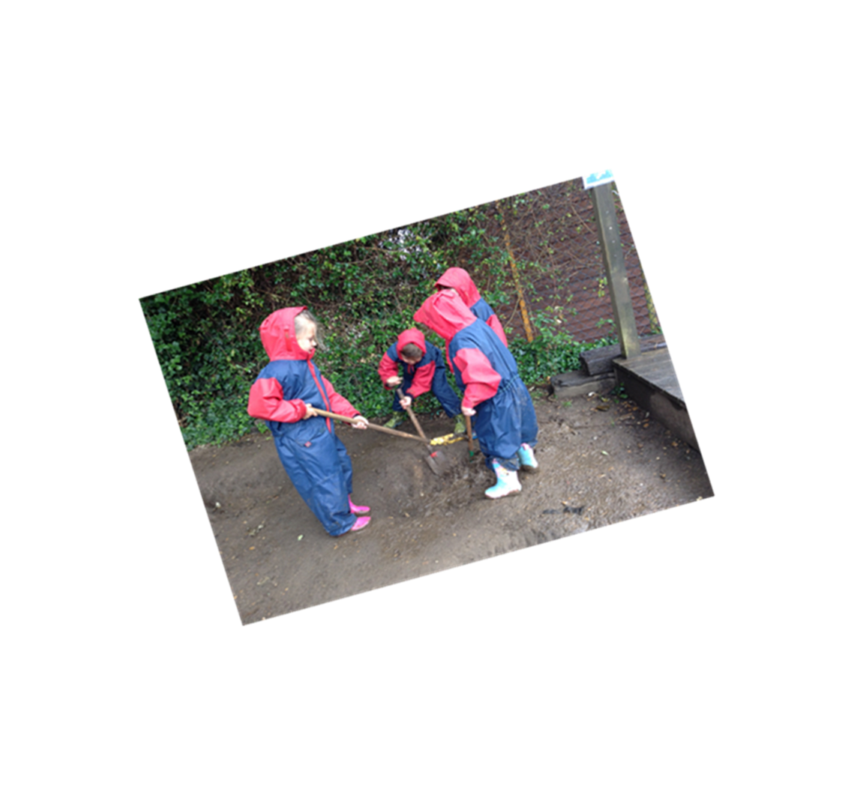
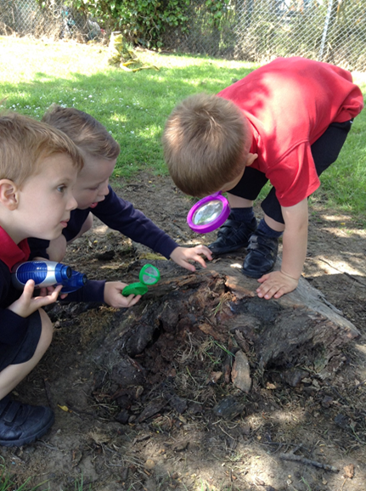
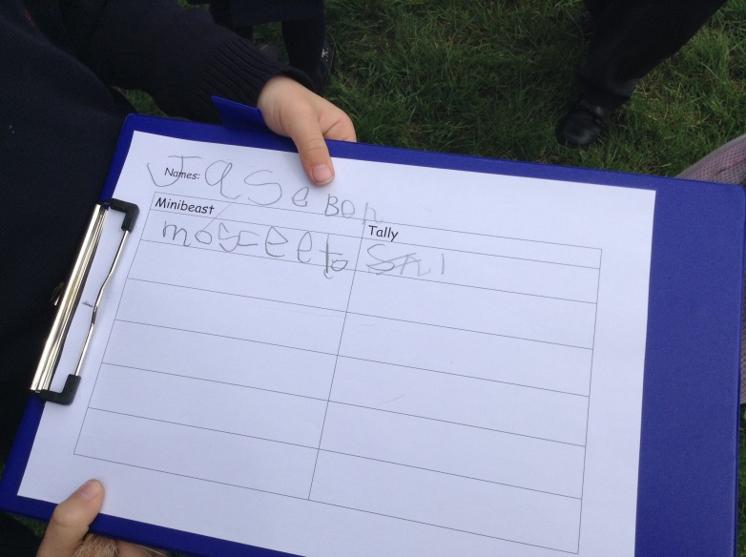
Rain or shine, we love to explore the outdoors….
We talk, we share, we dig, we play, we find out, we write and we count!

Slide 9
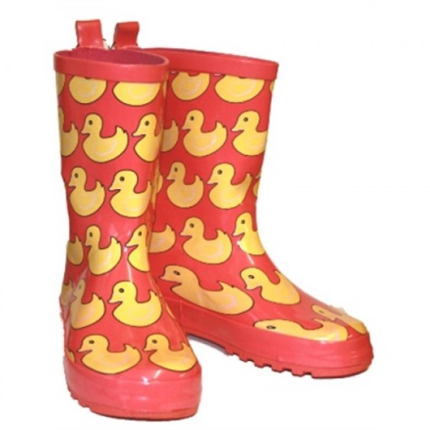
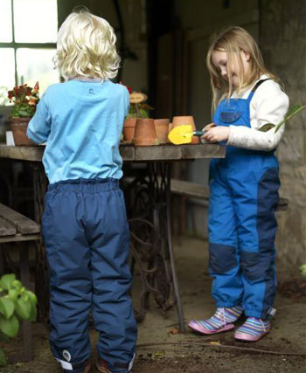
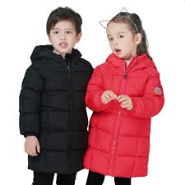
What I need to wear outside?
We will need wellies in school at all times.
Waterproof trousers will need to be sent in and kept in school too.
Please make sure your child brings in a warm coat in cold weather and a raincoat in wet weather – we will be outside rain or shine!

Slide 10
What else do I bring?
School book bag – bring in every day, including your reading diary and reading book.
Wellies – named and kept in school.
Waterproof trousers - named .
Please do not send in a rucksack as there is no space!

Slide 11
Lunch & Snacks
Snack Time
From September, fruit should be provided daily for morning snack.
Also, from September, children should be able to receive milk (free up to the age of 5 then payable thereafter). If the milk scheme restarts, children under 5 are automatically signed up. Please let us know if you do not want them to have milk.
Please send in a names sports bottle filled with water.
Please send in a piece of fruit/veg in a named container as an additional snack during the day.
Lunch
All Reception children are entitled to a free school meal. The Chartwells scheme and website details will be in your information packs. Meals need to be ordered in advance so please ensure the menus have been set up prior to your child starting school.

Slide 12
School Ready
We have included ideas for your child to be ‘School Ready’ in your information packs, including practising putting their coat on, and using the toilet independently.
Please ensure your child understands the importance of their own personal hygiene and frequent handwashing.

Slide 13
School Nurse
Our School Nurse will come into school for the children’s heights, weights, eyes and hearing checks throughout the year.
It is very important to make sure the children have these checks so any problems can be picked up early on!
A clinic number is available to speak to the School Nurse directly.
We will also upload the School Nursing Team’s ppt for further details.

Slide 14
Tapestry
Tapestry is our online Learning journal for your child.
We will use this throughout the year to send home observations of your child and keep you up to date with your child’s learning in school.
You can upload messages, photos and videos to us too and let us know about all the exciting times and moments that you see at home!

Slide 15
Tapestry
If you are reading this then you are already logged into Tapestry!
If you would like any other relatives to also access your child’s account then please could you send your child’s name, date of birth, their full name, their relationship to your child and their email address to ali.davies@ctkcps.com
Once their account is set up then they will receive an activation link and you will all receive the posts that are uploaded.

Slide 16
Zoom ‘Home Visits’
On Thursday 3rd September and Friday 4th September we will holding zoom ‘home visit’ meetings.
Information has been sent out to you via Tapestry.
This is a great opportunity to get to know your class teacher and TA and to ask any questions you might have. If you have any particular information about your child such as an allergy you can say at this time.
We hope this will be a special time for everyone.

Slide 17
Children will start part-time on Monday 7th September.
There will be different start times for this day only.
They will stay for either the morning or afternoon session for the whole of that week and the following week.
From Tuesday 8th September:
Morning sessions: 9-11.30am
Afternoon sessions: 12.30-3pm
Details of whether your child will be attending the morning or afternoon session will have been sent to you on Tapestry.
Children will be full time from Monday 21st September.

Slide 18
Where do we go…and when?
Your child’s first day – Monday 7th September
You will have an allocated time to arrive in the morning or afternoon.
Come in through the main entrance and round the left hand side of the school, past our Pre-school and round to the Reception outside area.
You will be welcomed by Mrs Tickel and brought to your classroom to meet your teacher and TA.
At the end of the session, please collect your child from their classroom door.
For the rest of that week, please bring your child to their classroom door for the beginning of the session.
Your date and time for the first day will have been sent to you on Tapestry.

Slide 19
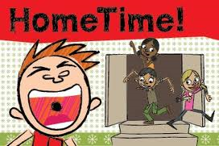
After that….. From Monday 21st September
Come to your Reception Class door.
We will send out details for our full-time start and finish times on Tapestry
Collect your child from their classroom door.

Slide 20
Breakfast Club and After-School Club
Due to Covid19, we are awaiting further confirmation that this will be in place for September. We will let you know once these details have been confirmed.
If so, children would be dropped off for Breakfast Club from 8am.
Children will be taken to After-School Club from their classes. After-School Club finishes at 6pm.
Any payments needs to be paid via the School Office.
Further information will be sent out once bookings can be made.

Slide 21
Reading
Your child will be given a school reading book – the first ones will not have any words – talk about the pictures and tell the story.
Read every day – choose a time that suits you and your child best, even if it’s only a couple of pages.
Record in their reading diary.
Later your child will be given high frequency words to learn, please practise these at home.

Slide 22
We will be using the Read write Inc Phonics scheme.
Your child will be given a Phonics Home Learning Folder in order to practise their sounds with you at home.

Slide 23
NAME IT OR LOSE IT!

Slide 24
A few comments from our parents…
…has loved every bit
of his time in Reception!
We’ve been amazed how much
he has learnt in his first year.
School is a fantastic, warm, loving environment where he feels happy and settled.
He has flourished and gained so
much confidence in every area
of his learning.
Fun, interactive learning means
she doesn’t see the learning as
hard work.
Her time in Reception has been
so fulfilling for herself and for us
to see.
My son loves CTK
school. He got all the
support he needs and
he is pushed to achieve
and do more.
My daughter turned 4 in the August
before starting and I was extremely
anxious how she would adapt to school
life being so young but although she got
upset most mornings the teachers were
so lovely and kind to my child and reassuring
to me that she enjoyed her days.
My only advice would be
buy bigger trousers with
adjustable waist and take
them up and when they
grow, just let the trousers
down. These kids grow so
fast!
You really tended to
my child’s personal
stage of development.
The progress she has made has
been amazing and I would highly
recommend this Reception/school.
So much learning in such a short space of time!

